Slide 1

Stroke Prediction
Bhavesh Khanchandani
© All rights reserved by Fireblaze Technologies Pvt. Ltd.

Slide 2
Problem Statement
According to the World Health Organization (WHO) stroke is the 2nd leading cause of death globally, responsible for approximately 11% of total deaths. This dataset is used to predict whether a patient is likely to get a stroke based on the input parameters like gender, age, various diseases, and smoking status.
© All rights reserved by Fireblaze Technologies Pvt. Ltd.

Slide 3
Proposed Solution
Data Preprocessing : This step performs all pre-processing steps such as data manipulation, data filling, converting categorical into numeric, and all processes. The EDA process involves performing 1. Univariate Analysis 2. Bivariate analysis 3. Removing Missing values if any / Outlier treatment 4. Machine Learning : Apply Appropriate machine learning algorithm to Predict the probability of a candidate will work for the company. and also check if the model is to be underfitting or overfitting if it has then solves this by using cross-validation technique, or perform hyper parameters tuning to improve model performance.
© All rights reserved by Fireblaze Technologies Pvt. Ltd.

Slide 4
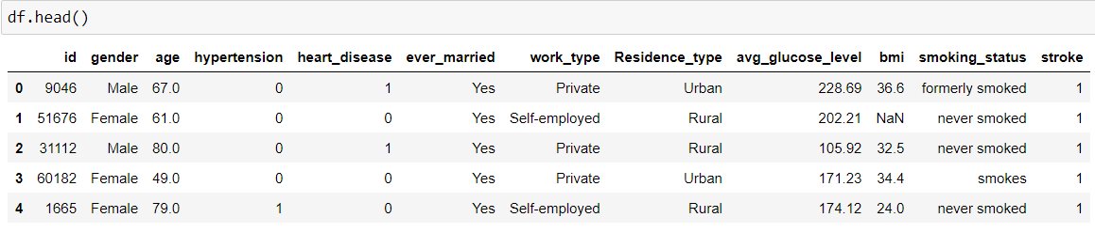
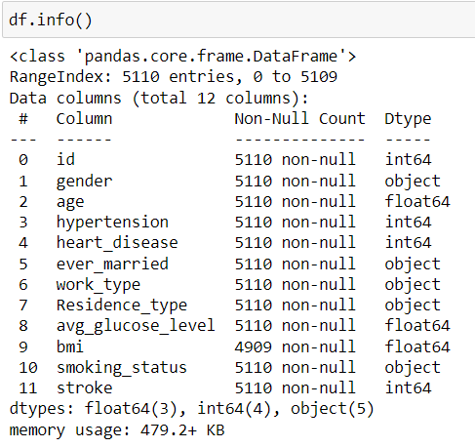
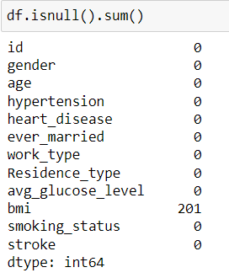
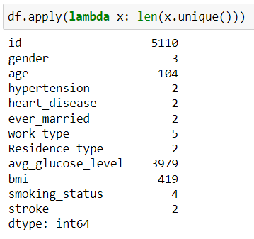
Descriptive Analysis
© All rights reserved by Fireblaze Technologies Pvt. Ltd.

Slide 5
Data Preprocessing
Drop Id column
Replace the missing values with mean of bmi attribute
Remove other gender because it has only 1 value
© All rights reserved by Fireblaze Technologies Pvt. Ltd.

Slide 6
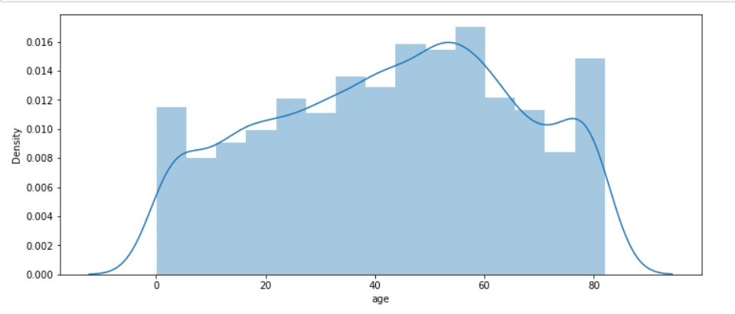
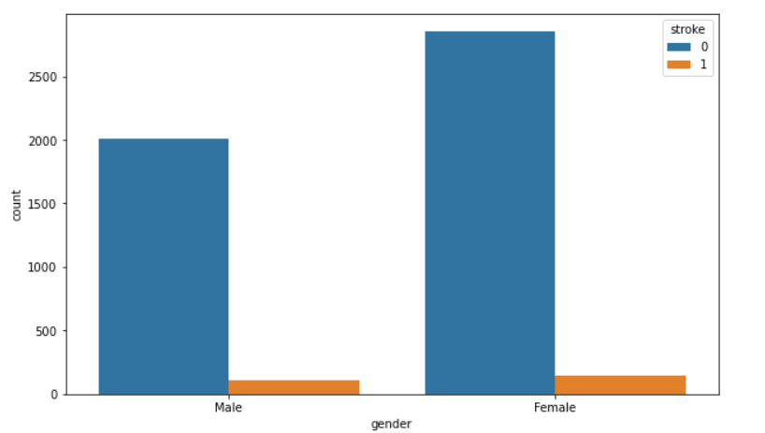
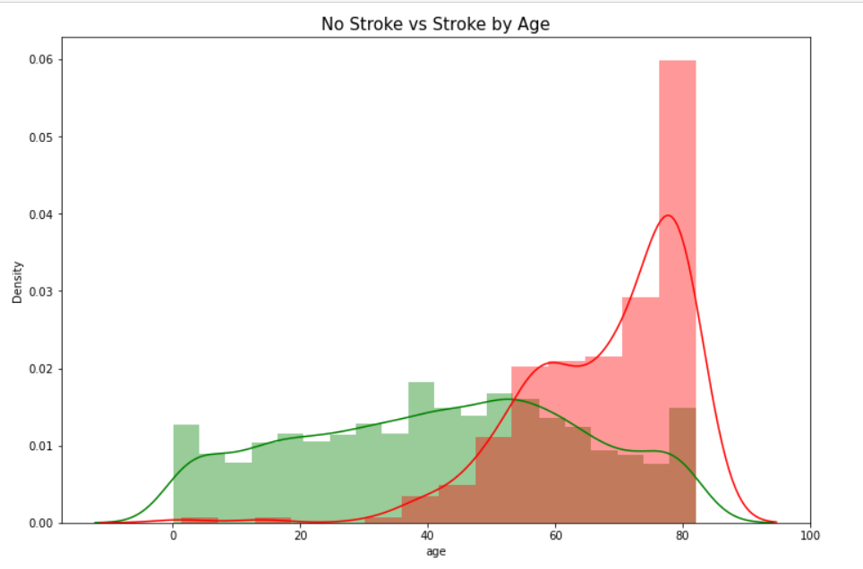
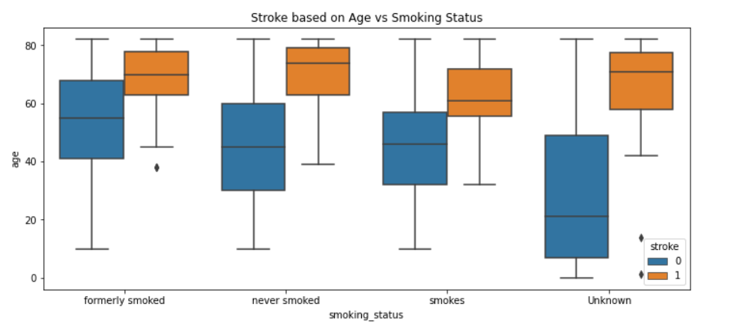
Exploratory Data Analysis
© All rights reserved by Fireblaze Technologies Pvt. Ltd.

Slide 7
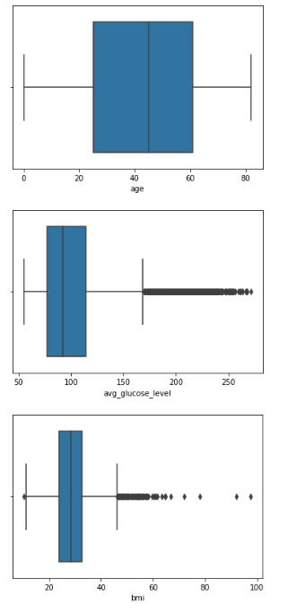
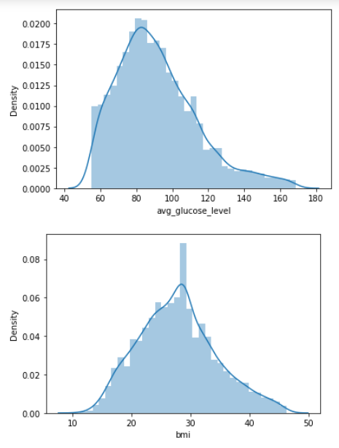
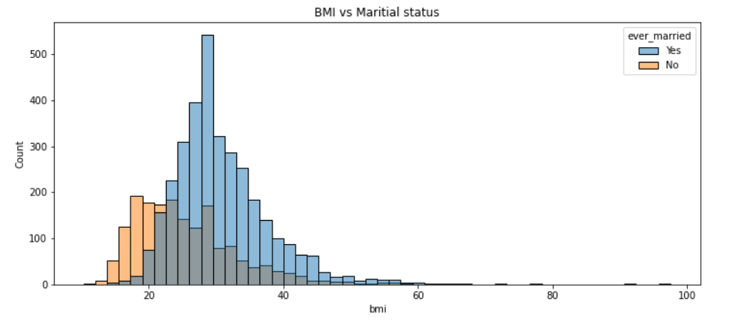
Exploratory Data Analysis
© All rights reserved by Fireblaze Technologies Pvt. Ltd.

Slide 8
Machine Learning Modelling
Feature selection for algorithm X = df.iloc[:,0:-1] y = df.iloc[:, -1] Selecting input and output features
Label encoding
Label encoded gender, ever_married and Residence_type columns
Split the data using Train test split
© All rights reserved by Fireblaze Technologies Pvt. Ltd.

Slide 9
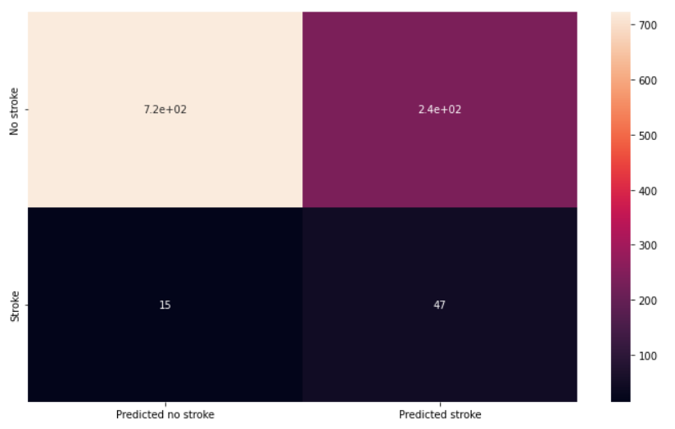
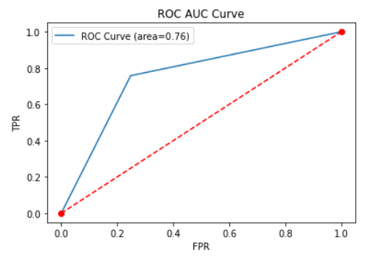
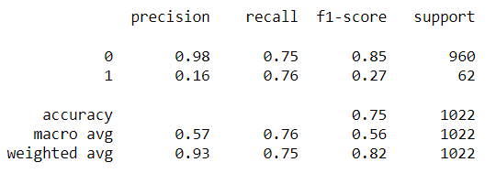
Machine Learning Modelling
Model selection , scores and other stats
Logistic Regression,
model score= 0.7524461839530333
Accuracy: 0.7524461839530333
© All rights reserved by Fireblaze Technologies Pvt. Ltd.

Slide 10
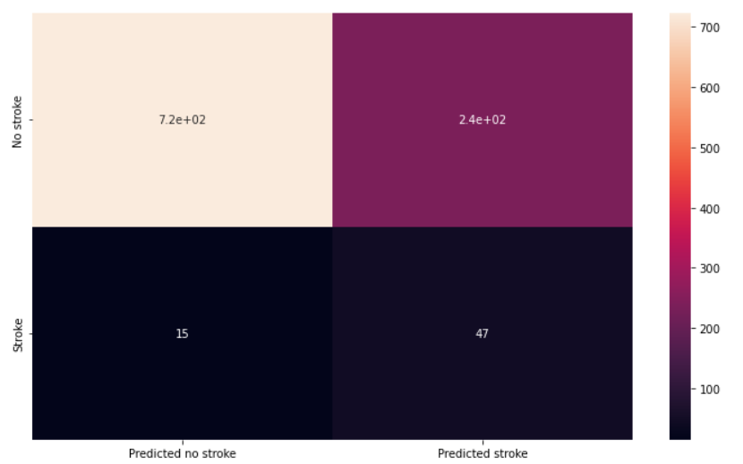
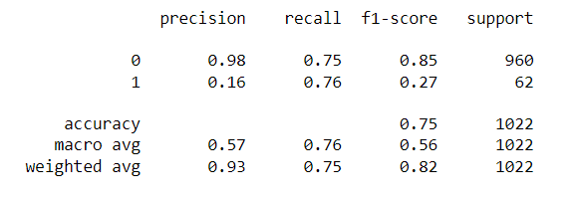
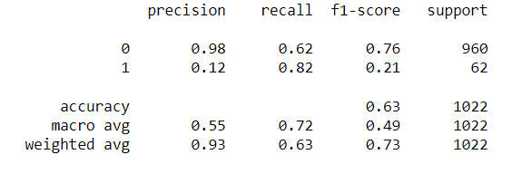
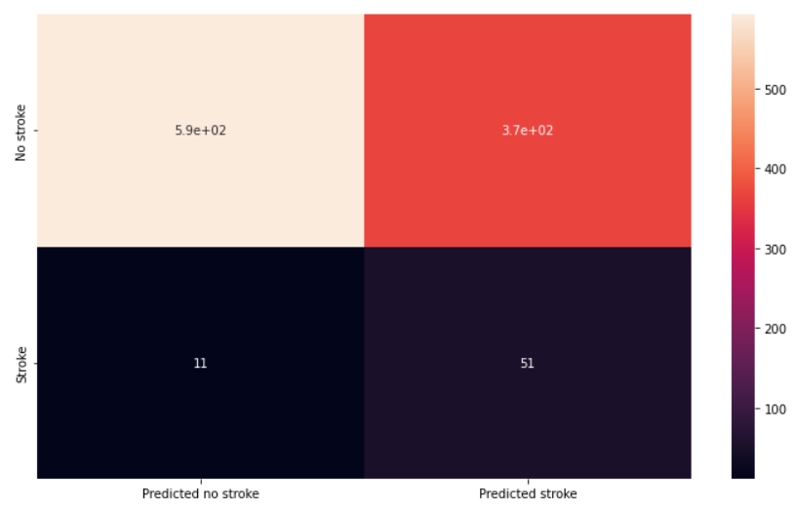
Machine Learning Modelling
KNN
Random Forest Classifier
© All rights reserved by Fireblaze Technologies Pvt. Ltd.

Slide 11
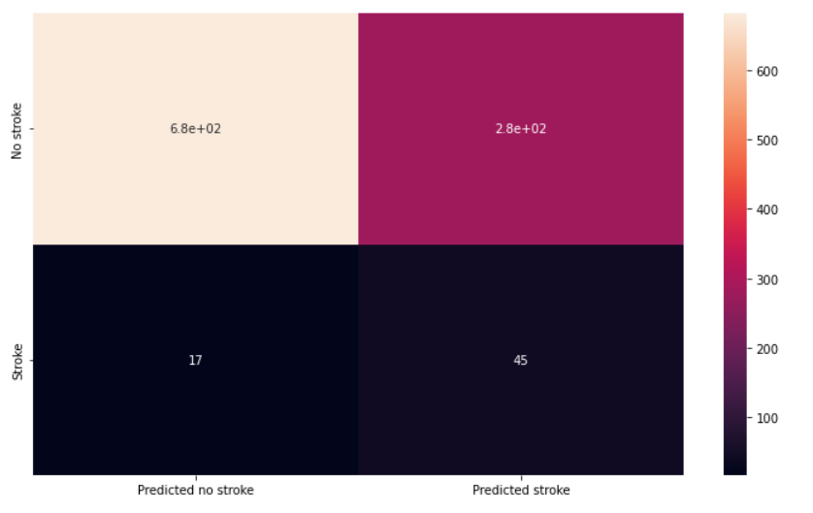
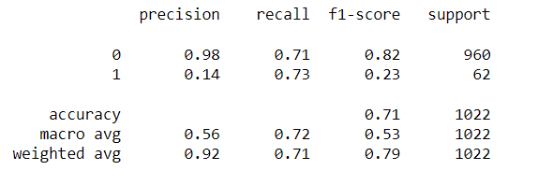
Machine Learning Modelling
DecisionTreeClassifier
© All rights reserved by Fireblaze Technologies Pvt. Ltd.

Slide 12
Hyperparameters Tuning
Logistic regression
KNN
Random Forest
Best Score is 79.33333333333333
Best Parameters is {'C': 0.01, 'penalty': 'l2'}
Best Score is 92.65384615384616
Best Parameters is {'metric': 'manhattan', 'n_neighbors': 5}
© All rights reserved by Fireblaze Technologies Pvt. Ltd.

Slide 13
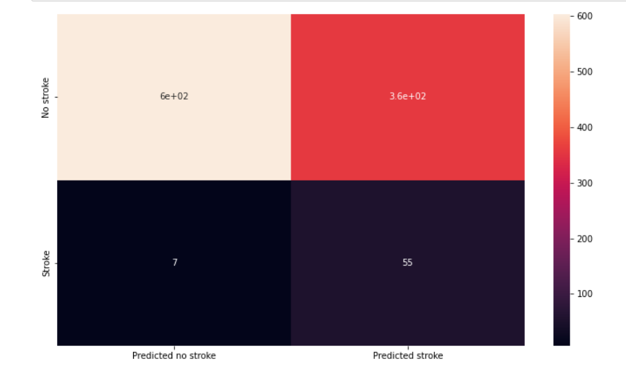
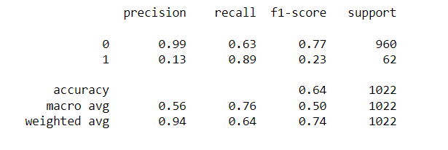
Conclusion
Now Let's apply the highest accuracy model with best hyperparameters model = RandomForestClassifier(n_estimators=200, criterion='entropy')
© All rights reserved by Fireblaze Technologies Pvt. Ltd.

